Slide 1

English language coaching & Leadership
Morocco 2022

Slide 2
Raison sociale
Lean English Solutions
SARL
Lieu
Forme juridique
Capital
100,000
Casablanca, Morocco

Slide 3


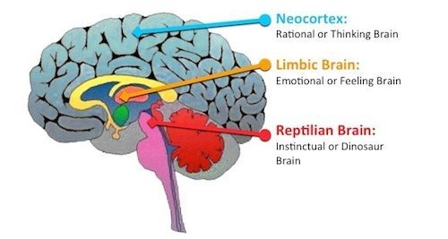
Learners have changed due to modern technology.
Attention span is getting less and less.
Learners are needing more experiential and conceptual type of learning.

Slide 4
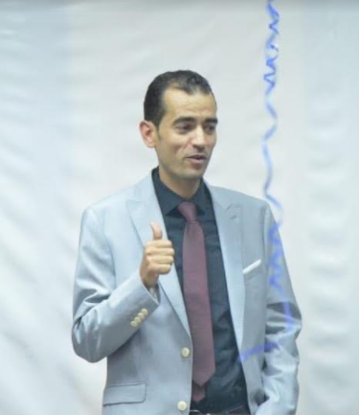
Apres plus de 16 ans dans le domaine du coaching en Anglais, On a constaté que la confiance d'un apprenant à communiquer ne dépend pas du nombre de règles de grammaire qu'il connaît.
Les manuels et les salles de classe vous donneront un bon départ, mais la capacité de communiquer avec autrui vient avec la pratique et le sentiment d'être engagé dans un environnement confortable.
Kamal FAIZ
English Language Coach
NLP Practitioner

Slide 5

About
Us.
L.E.S provides a wide range of English Language solutions and soft skills training.
L.E.S uses a lean programme and a blended system of online, one-to-one and small group lessons to help business professionals compete in a Global Market and take their English skills to the next level.
Copyright@ Lean Academy

Slide 6


Interactive Model of Communication
Live sessions
Anywhere Anytime
Watch & Discuss
LEARNER’s Centered Approach.
Constant Feedback
Speaking Activities

Slide 7





WHAT WE OFFER
General & ESP English
Cambridge English Exams
E-learning
Professional Exchange Programs
Follow-ups
Coaching
Leadership Programs
Workshops

Slide 8

TRAINING PROCESS
01
LEVEL TESTING
STEP
Administering both a written and an oral diagnostic test
02
NEEDS ANALYSIS
STEP
Collecting data from clients and analyse their needs.
SPEAK TO A TRAINER
03
STEP
Weekly live or in person sessions with an experienced trainer
04
RESULT & FEEDBACK
STEP
Start - Stop - Continue.

Slide 9


PLANNING-draft
Upon request– In the best interest of your TEAM
BLENDED LEARNING SYSTEM BETWEEN ONLINE AND IN-COMPANY TRAINING
Online
In company
At our center

Slide 10
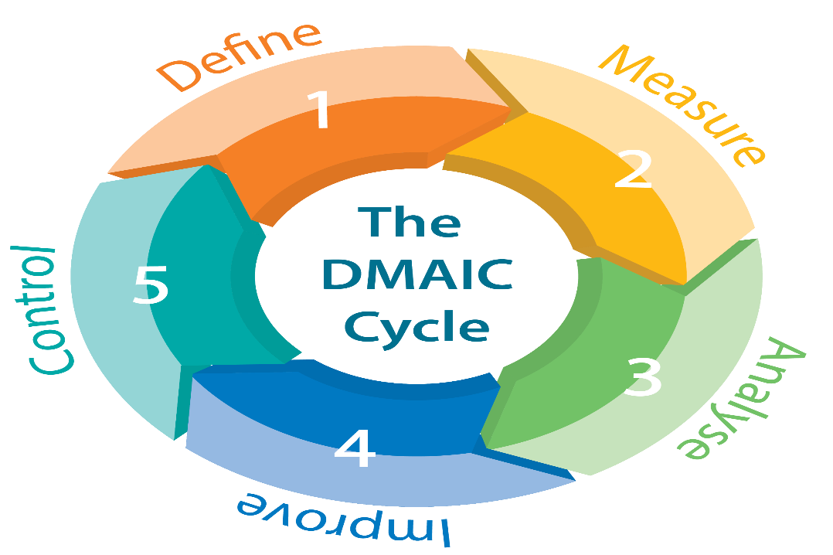
Our methodology
Define : Level test ( Written + Oral )
Measure : Narrowing the training focus
Analyse : Identify the weaknesses and opportunities
Improve : Generating solutions then piloting
Control : Assessing the training through continuous feedback
Copyright@ Lean Academy

Slide 11
Corporate Solutions
Lean English Solutions offers you the best corporate training solutions to your team requirements.
Corporate Branding, Executive coaching, Soft skills, Presentation skills , Negotiation skills, Communication skills, Personal Development , Salesforce , NLP Training…
Copyright@ Lean Academy

Slide 12
Lean-Talk
Our leverage is to connect you live to both national and international consultants in a way to boost your speaking skills and help you gain confidence leading converstaions in English..
Copyright@ Lean Academy

Slide 13
Language coaching workshops
Our workshops’ topics include grammar and pronunciation language objectives. The instructor builds a tailored course based on the LEANER’s needs.
Presentations topics
Negotiations topics
Leadership topics
Meetings topics
Conference calls topics
HR topics
Written communication topics
English language workshops are conducted over one week and provide up to 30 hours
of contact with professional English speaking instructors

Slide 14
Emotional Intelligence
RELATIONSHIP-MANAGEMENT
SELF-AWARENESS
SELF-MANAGMENT
SOCIAL AWARENESS
75%
50%
80%
45%

Slide 15
After successfully passing 85% of the training objectives…
You will be eligible to get your English Level Certificate in Medical English.
CERTIFICATE

Slide 17
















Slide 18
Client Testimonials

Slide 19

“ I believe I have made the right decision choosing your team. Your methodology is unique and interactive. Last year, I couldn’t imagine myself writing you in English . I am really grateful.. »
Ms. Amina R
SENIOR ACTUARY

Slide 20

“ I congratulate you and your team for the brilliant way of conducting both the business workshops and the social clubs at our ocp centers…thanks a lot »
Mr H.Bedri

Slide 21
« Your workshops and follow-ups have made a difference, My team and I have been always grateful to your hardwork…your international experience has contributed to a better understanding of practising leadership skills in our HR departement »
Ms. H.ALAMI
HR Manager

Slide 22
« Pendant une période de 2 semestres j’ai pu bénéficier d’une formation professionnelle en Anglais Medical avec L.E.S qui a fait preuve de professionnalisme et d’engagement infaillibles. Je suis entièrement satisfaite de l’enseignement prodigué .»
Dr Achour Jihane
Hépato-Gastro- Entérologue
RABAT

Slide 23

« Practising through conference calls has helped a lot to deal with my international clients and colleagues as well. I had some serious difficuties in listening and speaking, now I feel more confident thanks to you Mr. Kamal and your team I am progressing and guess what, a career shift is on the way ☺ »
Mr. Saaddeddine Abdelhamid
Sales Executive
Copyright@ Lean Academy

Slide 24

“ I’d like to thank you for the way you handled the first English workshop at Upline Capital Management with a very friendly, intelligent and motivating way.
Consequently, this makes me feel very confident about the future results.”
M. DINAR
Directeur Général
UPLINE CAPITAL MANAGEMENT

Slide 25
Revealing your character…
K.faiz@englishsolutions.com
www.leanenglishsolutions.com*
Website is Under construction
Copyright@ Lean Academy

Slide 26
THANK YOU

